Slide 1
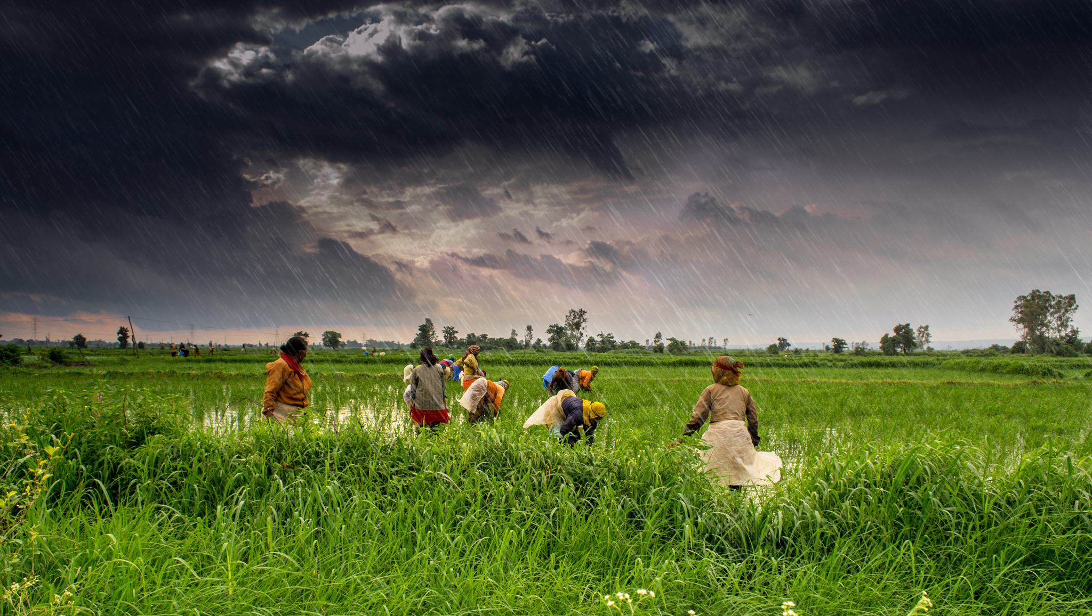
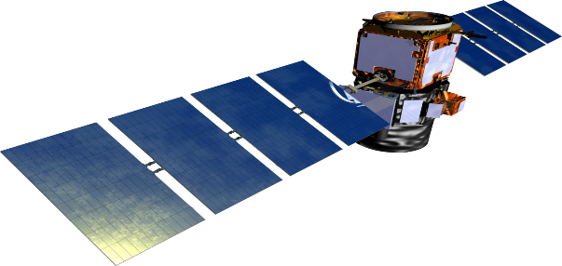
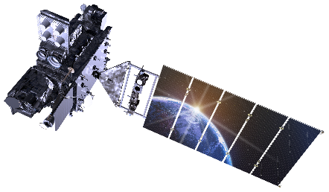
Satellite Imagery Analysis For
Predicting Food Supply in India
Akshay Kumar Ujjwal Vats Rishabh Prabhakar Gaurav Bajpai .

Slide 2
Introduction
In the last few decades-strides in technology, irrigation practices, extension services, and with progressive agricultural policies, India has seen improvement in food.
Our project is also a contribution from our side to this improvement.
What we are trying to implement , other countries are already getting benefited from this.
The project Idea is based on the Data Science-”spatial data analysis”.
Our project requires simple tasks which has to be done with strategy-Getting the data in the form of image , Analysing those data and predicting the result based on the analysis.
It’s the prediction based on the previous year of data and not the judgement . It may be wrong sometime but do work for most of the time.

Slide 3
Existing System
India’s fivefold increase in grain production in last 50 years still faces problems of malnutrition and food insecurity.
The capacity to produce enough quality food is falling behind human numbers.
In our country, food is wasted worth of 10 billion people.
Our country produces surplus amount of food each year, but there is lack of proper supply chain.
Women and children are the most vulnerable to micronutrient deficiencies. This has adverse affects on their health.

Slide 4
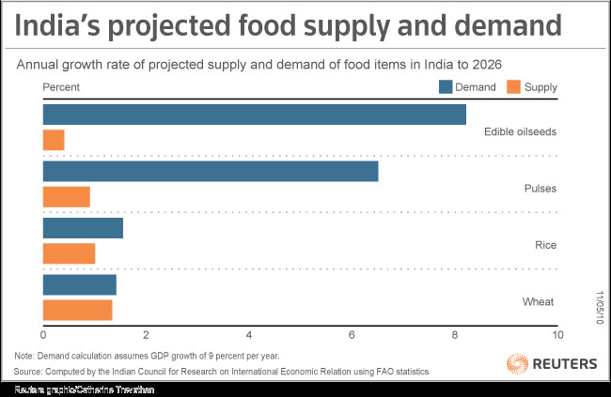
The Actual Problem…
The world’s population is booming. According to estimates, the global population is likely to exceed 9 billion by 2050, with 5 billion people in Asia alone.
Food production in the region must keep pace.
Even as environment sustainability and
economic development are ensured.
Even after being aware of the situation
and issue , have not developed any
solution regarding this.
Having food for all , but is not available
to all

Slide 5
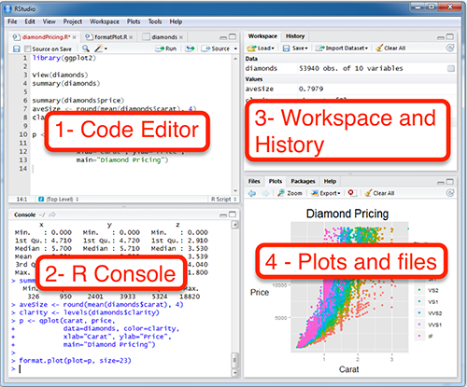
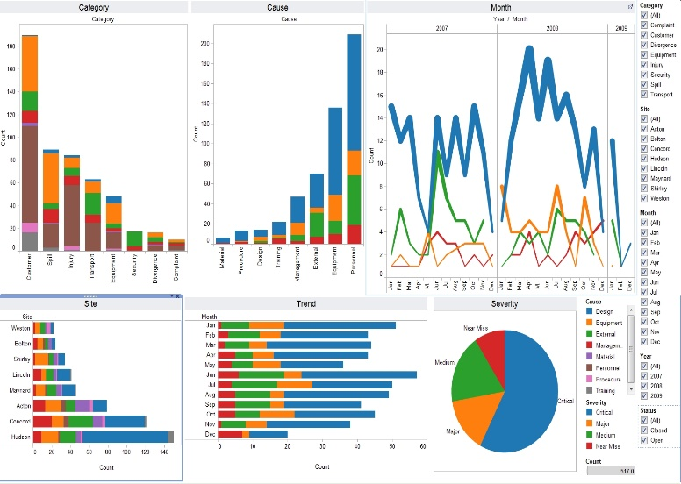

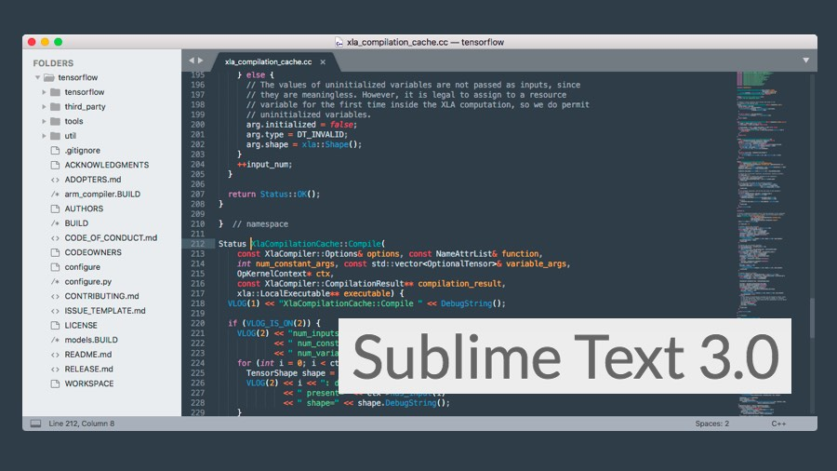
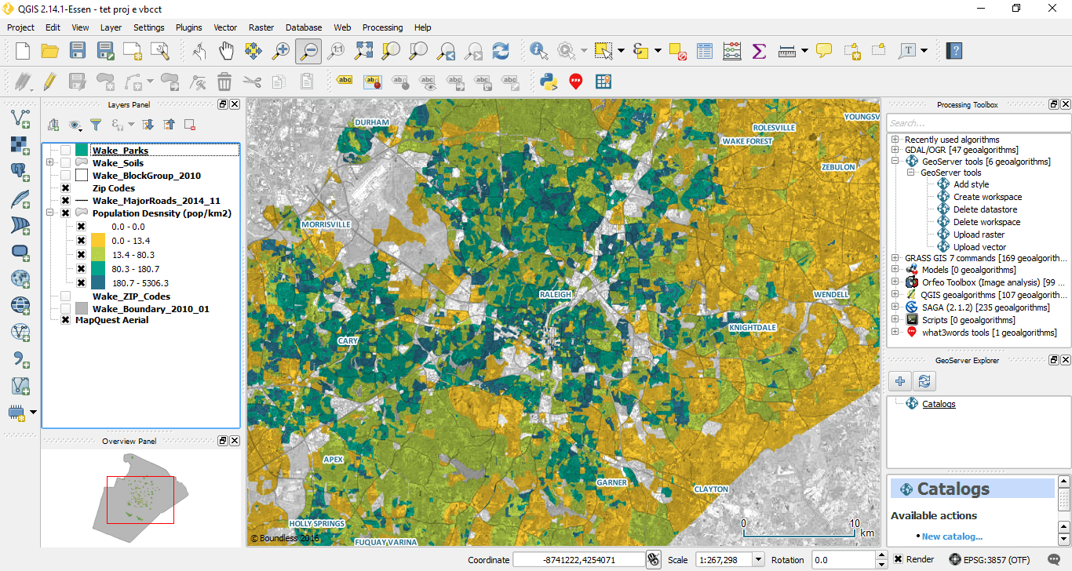

Requirements Software/Hardware
RStudio
Tableau 10.2
Tableau
Sublime Text 3.0
QGIS 2.18

Slide 6

Requirements Software/Hardware
RAM-8GB
Memory-1TB
Graphics-2GB
Processor-intel i5(7th Gen)

Slide 7
Requirements Technical/Non-Technical
Technical
Knowledge of R programming-Familiar with the packages used
for spatial Data Analysis.
Knowledge of Markup Language (HTML) and Styling sheet language (CSS)
which describes the appearance of the Markup language.
Non-Technical
Raw Data which is the High Resolution Vegetation image of our country.
This projects actually requires lots of research work since there are very less online
resource available related to the project.

Slide 8
Issue in existing methodology
Data analytics and novel data collection methods are increasingly powerful but have largely not been applied.
This is because of key gaps in data availability and modelling. This initiative intends to fix this.
Other reasons may be political or financial or anything else.
Most importantly, it is crucial to continue to identify issues and seek evidence-based solutions through research.
Problem of insufficient supply chain and awareness , not food shortage.

Slide 9
Need for new methodology
Currently experiencing a dramatic increase in agricultural research capacity by using a combination of detailed environmental and genetic data.
Other countries like USA have already implemented this and getting benefitted.
To improve the proper food supply in the country.
The part of the country which are producing more foods can contribute to low producing area.
If implemented successfully there will be various benefits:
-reduction in farmers suicide rate.
-can save surplus food for emergency.
-reduction in issue of starvation.

Slide 10
Method Of Implementation
Collect Raw data in the form of images
Cleaning of data.
Initial analysis of the data.
Installing the packages to be used in the analysis-’raster’,’jpeg,’sp’,etc.
Setting the working directory and reading the images data.
Extracting the statistical information from the data.
Visualization of the images.
Performing mathematical operations.
Predicting the result based on the image classification.
Preparing a web report with some additional features.

Slide 11
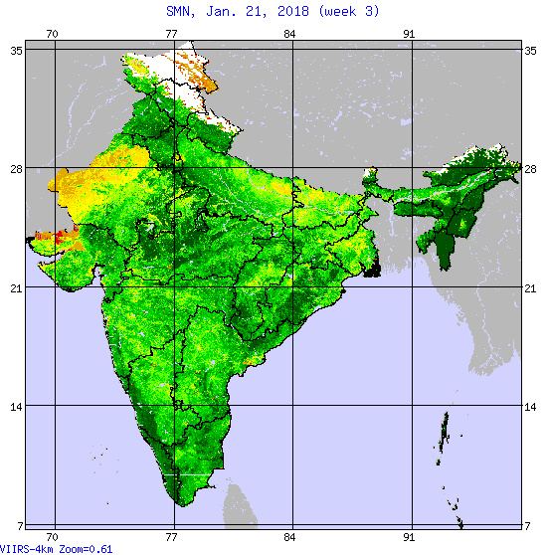
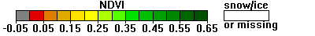
USGS
NOAA STAR
No Noise NDVI image

Slide 12
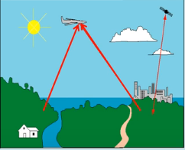
How the data is obtained??

Slide 13
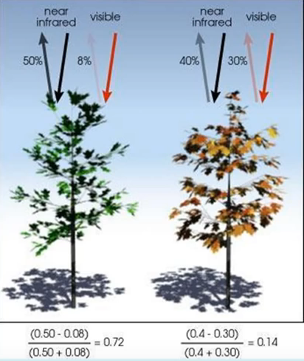
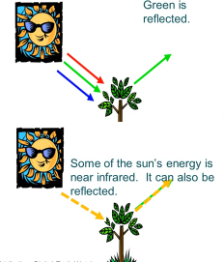
Greenness as a parameter to measure vegetation and
Calculating NDVI (Normalized Difference Vegetation Index)
NDVI=(NIR-RED)/(NIR+RED)

Slide 14
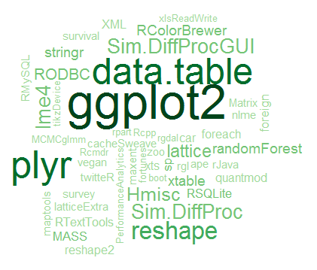
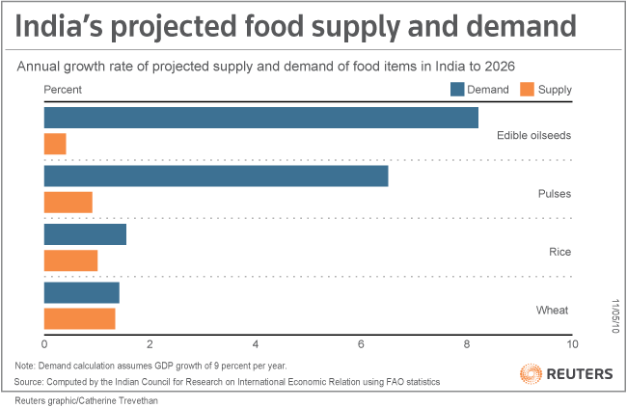
Getting all resources and Initial analysis
R packages will perform the job for this project
efficiently.
There are several packages available for the analysis
of spatial Data. We will mostly make use
of two or three.
The first and foremost thing after getting ready with all resource is to analyse the data initially.
The data may be in a csv file or it may be a image.

Slide 15
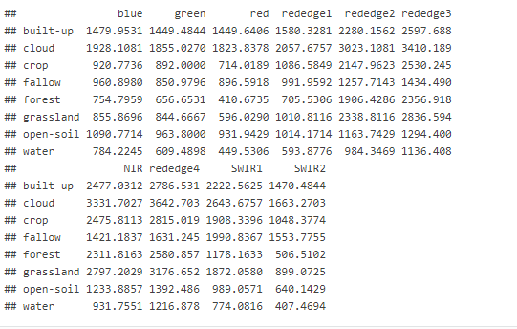
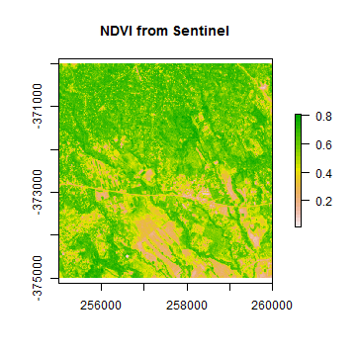
Image information and visualization
This is how image looks like after performing some analysis.
Greater the greenness in the image healthier the vegetation is.

Slide 16
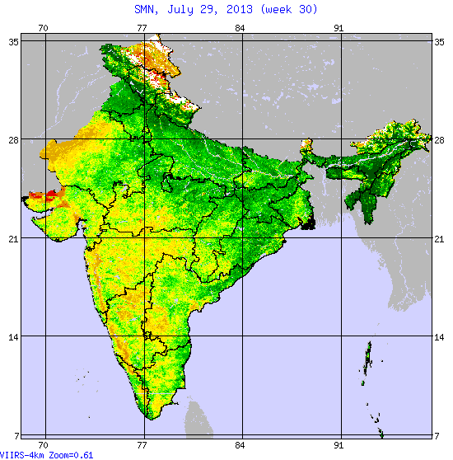
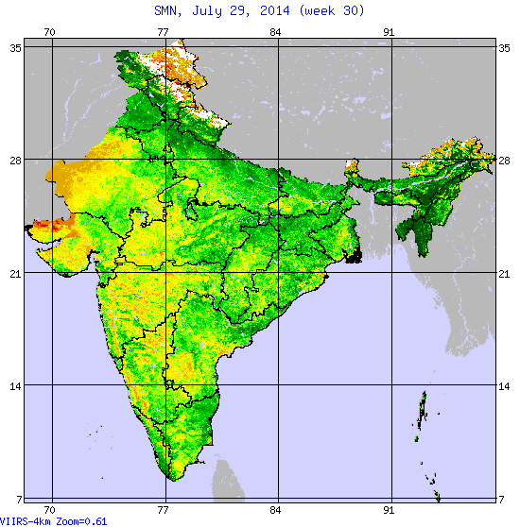
Result Prediction

Slide 17
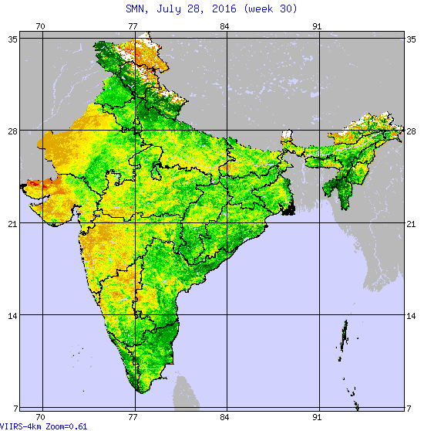
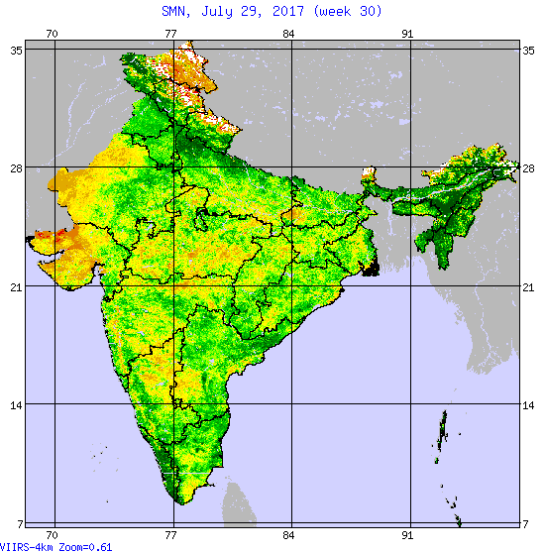
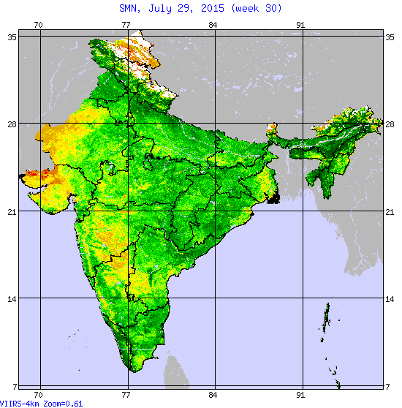
July 29,2015 (week 30)
July 29,2016 (week 30)

Slide 18

Making a Web Report
Our Web report will include statistics and visualization of five states of our country related to agriculture.
It will also consists of all our project work including code and result. One can also get the nearest
FCI office location .
The whole analysis will be summarized into this web report.

Slide 19
System Design
Getting Data
(No Noise NDVI Image)
Extracting Information from data
Performing operations and visualizing
Cleaning Data
(Keeping Useful Data)
Analysing Images
Result
Web Report
Overview of the data
(Initial Analysis)
Getting Resources
(Packages)

Slide 20

Project Schedule/Planning

